Slide 1
Lecture 1.
Introduction to Databases

Slide 2
Database Applications Examples
•
Enterprise Information
•
•
Sales: customers, products, purchases Accounting: payments, receipts, assets
Human Resources: Information about employees, salaries, payroll taxes.
Manufacturing: management of production, inventory, orders, supply chain.
Banking and finance
•
•
•
customer information, accounts, loans, and banking transactions. Credit card transactions
Finance: sales and purchases of financial instruments (e.g., stocks and
bonds; storing real-time market data
Universities: registration, grades

Slide 3
Database Applications Examples (Cont.)
Airlines: reservations, schedules
Telecommunication: records of calls, texts, and data usage, generating monthly bills, maintaining balances on prepaid calling cards
Web-based services
  Online retailers: order tracking, customized recommendations
  Online advertisements
Document databases
Navigation systems: For maintaining the locations of varies places of interest along with the exact routes of roads, train systems, buses, etc.

Slide 4
Purpose of Database Systems
In the early days, database applications were built directly on top of file systems, which leads to:
Data redundancy and inconsistency: data is stored in multiple file formats resulting induplication of information in different files
Difficulty in accessing data
  Need to write a new program to carry out each new task
Data isolation
  Multiple files and formats
Document databases
Integrity problems
•
•
Integrity constraints (e.g., account balance > 0) become “buried” in program code rather than being stated explicitly
Hard to add new constraints or change existing ones

Slide 5
Purpose of Database Systems (Cont.)
•
Atomicity of updates
•
•
Failures may leave database in an inconsistent state with partial updates carried out
Example: Transfer of funds from one account to another should either
complete or not happen at all
Concurrent access by multiple users
•
•
Concurrent access needed for performance
Uncontrolled concurrent accesses can lead to inconsistencies
Ex: Two people reading a balance (say 100) and updating it by withdrawing money (say 50 each) at the same time
Security problems
  Hard to provide user access to some, but not all, data
Database systems offer solutions to all the above problems

Slide 6
University Database Example
In this text we will be using a university database to illustrate all the concepts
Data consists of information about:
  Students
  Instructors
  Classes
Application program examples:
  Add new students, instructors, and courses
  Register students for courses, and generate class rosters
  Assign grades to students, compute grade point averages (GPA) and generate transcripts

Slide 7

A database is nothing more than a set of related information

Slide 8
View of Data
A database system is a collection of interrelated data and a set of programs that allow users to access and modify these data.
A major purpose of a database system is to provide users with an abstract view of the data.
  Data models
    A collection of conceptual tools for describing data, data relationships, data semantics, and consistency constraints.
  Data abstraction
    Hide the complexity of data structures to represent data in the database from users through several levels of data abstraction.

Slide 9
Data Models
A collection of tools for describing
  Data
  Data relationships
  Data semantics
  Data constraints
Relational model
Entity-Relationship data model (mainly for database design)
Object-based data models (Object-oriented and Object-relational)
Semi-structured data model (XML)
Other older models:
  Network model
  Hierarchical model

Slide 10

The Relational Model
Dr. E. F. Codd
1970
«A Relational Model of Data for Large Shared Data Banks»

Slide 11
The Relational Model
Data can be represented as sets of tables.
Rather than using pointers to navigate between related entities, redundant data is used to link records in different tables.

Slide 12
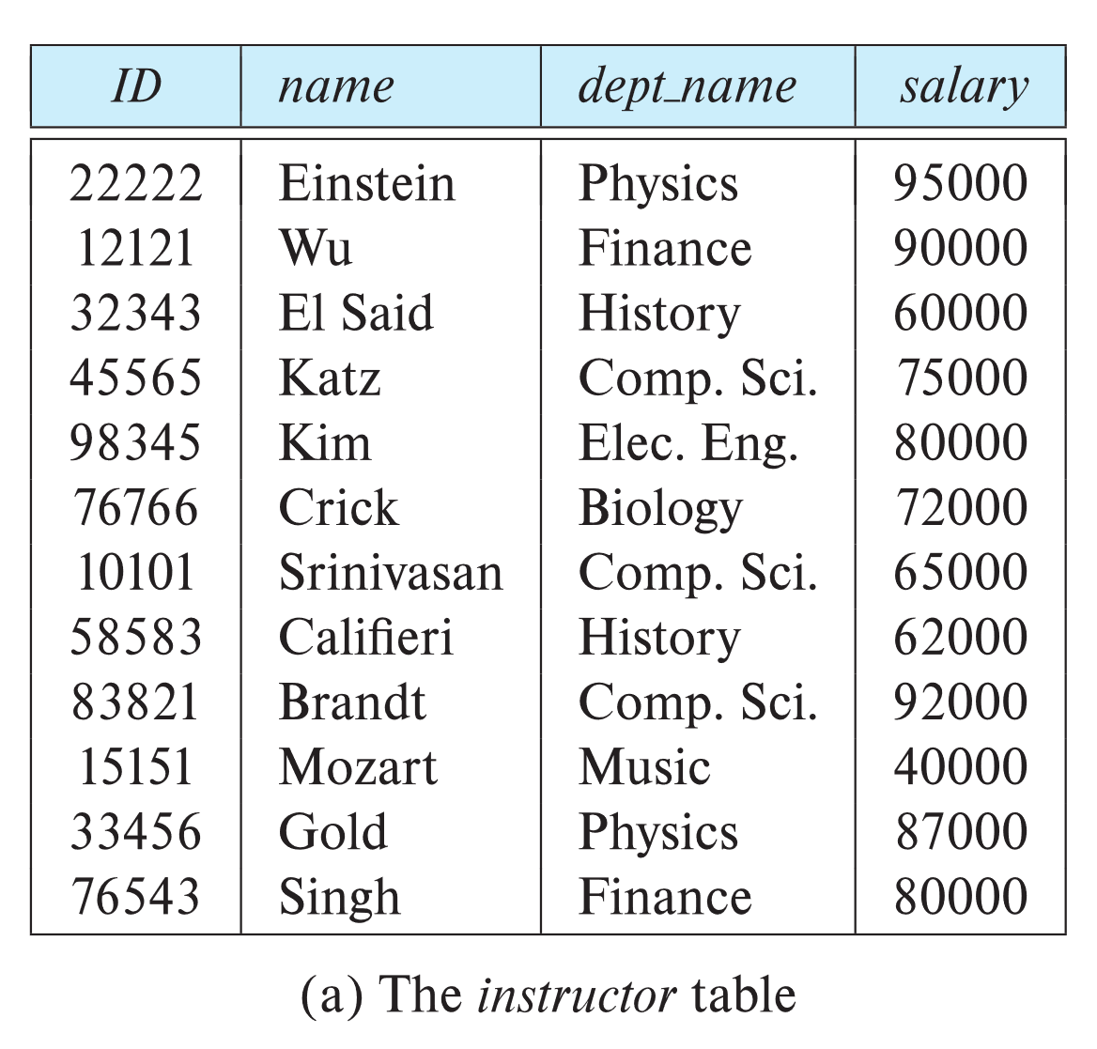
Relational Model
All the data is stored in various tables.
Example of tabular data in the relational model
Columns
Rows

Slide 13
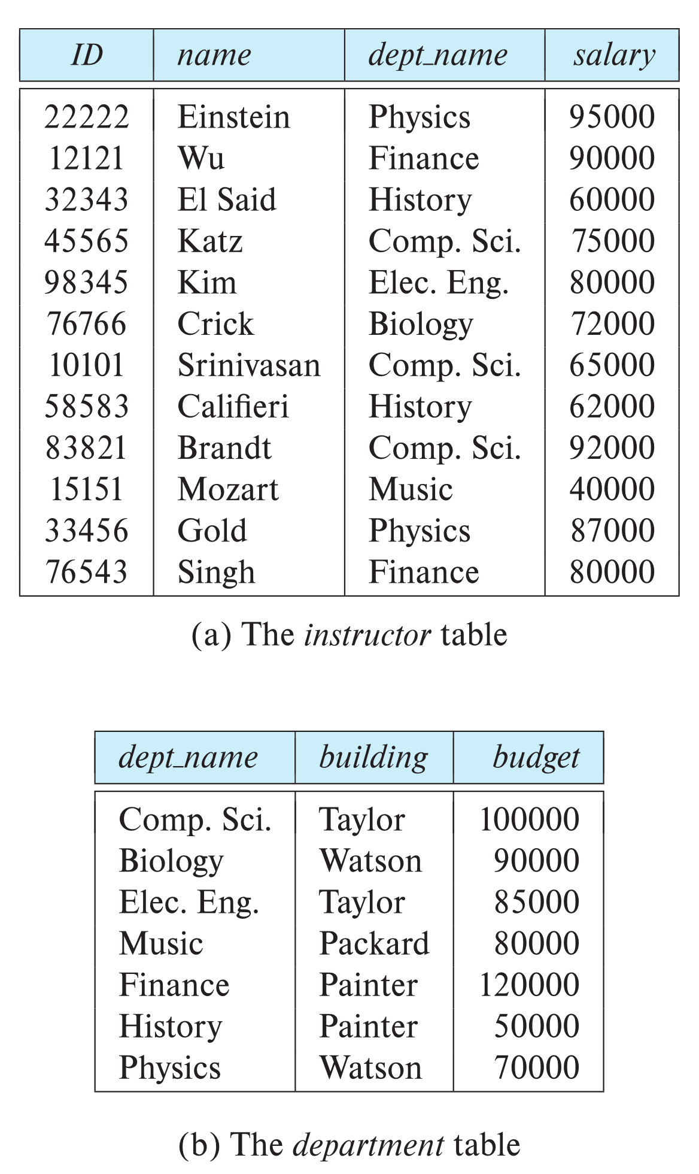
Relational Model

Slide 14
Levels of Abstraction
Physical level: describes how a record (e.g., instructor) is stored.
Logical level: describes data stored in database, and the relationships among the data.
type instructor = record
ID : string;
name : string; dept_name : string; salary : integer;
end;
View level: application programs hide details of data types. Views can also hide information (such as an employee’s salary) for security purposes.

Slide 15
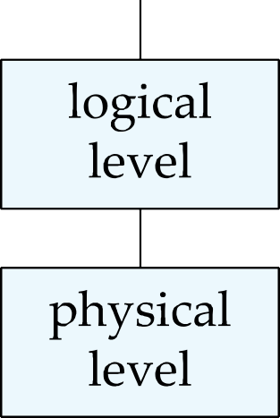
Levels of Abstraction
An architecture for a database system

Slide 16
Instances and Schemas
Similar to types and variables in programming languages
Logical Schema – the overall logical structure of the database
  Example: The database consists of information about a set of customers and accounts in a bank and the relationship between them
    Analogous to type information of a variable in a program
Physical schema – the overall physical structure of the database
Instance – the actual content of the database at a particular point in time
  Analogous to the value of a variable

Slide 17
Physical Data Independence
Physical Data Independence – the ability to modify the physical schema without changing the logical schema
  Applications depend on the logical schema
  In general, the interfaces between the various levels and components should be well defined so that changes in some parts do not seriously influence others.

Slide 18
Data Definition Language (DDL)
Specification notation for defining the database schema Example: create table instructor (
ID
name
char(5), varchar(20),
dept_name varchar(20),
salary numeric(8,2))
DDL compiler generates a set of table templates stored in a data dictionary
Data dictionary contains metadata (i.e., data about data)
  Database schema
  Integrity constraints
    Primary key (ID uniquely identifies instructors)
  Authorization
    Who can access what

Slide 19
Data Definition Language (DDL)
CREATE TABLE corporation (corp_id SMALLINT,
name VARCHAR(30),
CONSTRAINT pk_corporation PRIMARY KEY (corp_id)
);

Slide 20
Data Manipulation Language (DML)
Language for accessing and updating the data organized by the appropriate data model
  DML also known as query language
There are basically two types of data-manipulation language
  Procedural DML -- require a user to specify what data are needed and how to get those data.
  Declarative DML -- require a user to specify what data are needed without specifying how to get those data.
Declarative DMLs are usually easier to learn and use than are procedural DMLs.
Declarative DMLs are also referred to as non-procedural DMLs
The portion of a DML that involves information retrieval is called a
query language.

Slide 21
Data Manipulation Language (DML)
INSERT INTO corporation (corp_id, name) VALUES (27, 'Acme Paper Corporation');

Slide 22
Retrieve inserted row
SELECT name FROM corporation WHERE corp_id = 27;
+ - - - - - - - — - - - - +
| name |
+ - - - - - - - — - - - - +
| Acme Paper Corporation |
+ - - - - - - - — - - - - +

Slide 23
SQL Query Language
SQL query language is nonprocedural. A query takes as input several tables (possibly only one) and always returns a single table.
Example to find all instructors in Comp. Sci. dept
select name
from instructor
where dept_name = 'Comp. Sci.'
To be able to compute complex functions SQL is usually embedded in some higher-level language
Application programs generally access databases through one of
  Language extensions to allow embedded SQL
  Application program interface (e.g., ODBC/JDBC) which allow SQL queries to be sent to a database

Slide 24
Database Access from Application Program
SQL does not support actions such as input from users, output to displays, or communication over the network.
Such computations and actions must be written in a host language, such as C/C++, Java or Python, with embedded SQL queries that access the data in the database.
Application programs -- are programs that are used to interact with the database in this fashion.

Slide 25
Database Design
The process of designing the general structure of the database:
Logical Design – Deciding on the database schema. Database design requires that we find a “good” collection of relation schemas.
  Business decision – What attributes should we record in the database?
  Computer Science decision – What relation schemas should we have and how should the attributes be distributed among the various relation schemas?
Physical Design – Deciding on the physical layout of the database

Slide 26
Database Engine
A database system is partitioned into modules that deal with each of the responsibilities of the overall system.
The functional components of a database system can be divided into
  The storage manager,
  The query processor component,
  The transaction management component.

Slide 27
Storage Manager
A program module that provides the interface between the low-level data stored in the database and the application programs and queries submitted to the system.
The storage manager is responsible to the following tasks:
  Interaction with the OS file manager
  Efficient storing, retrieving and updating of data
The storage manager components include:
  Authorization and integrity manager
  Transaction manager
  File manager
  Buffer manager

Slide 28
Storage Manager (Cont.)
The storage manager implements several data structures as part of the physical system implementation:
  Data files -- store the database itself
  Data dictionary -- stores metadata about the structure of the database, in particular the schema of the database.
  Indices -- can provide fast access to data items. A database index provides pointers to those data items that hold a particular value.

Slide 29
Query Processor
The query processor components include:
  DDL interpreter -- interprets DDL statements and records the definitions in the data dictionary.
  DML compiler -- translates DML statements in a query language into an evaluation plan consisting of low-level instructions that the query evaluation engine understands.
    The DML compiler performs query optimization; that is, it picks the lowest cost evaluation plan from among the various alternatives.
  Query evaluation engine -- executes low-level instructions generated by the DML compiler.

Slide 30
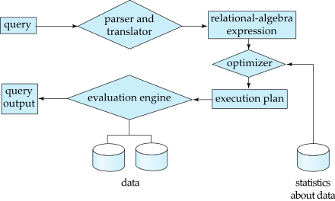
Query Processing
Parsing and translation
Optimization
Evaluation

Slide 31
Transaction Management
A transaction is a collection of operations that performs a single logical function in a database application
Transaction-management component ensures that the database remains in a consistent (correct) state despite system failures (e.g., power failures and operating system crashes) and transaction failures.
Concurrency-control manager controls the interaction among the concurrent transactions, to ensure the consistency of the database.

Slide 32
SQL transaction statements
BEGIN;
UPDATE accounts SET balance = balance - 100.00 WHERE name = 'Alice';
-- etc etc ROLLBACK; COMMIT;

Slide 33
DBMS (Database Management System)
MySQL
MS SQL Server (Microsoft)
Oracle DB (Oracle)
DB2 Universal Database (IBM)
PostgreSQL (PostgreSQL GDG)

Slide 34

Why PostgreSQL?
PostgreSQL is an enterprise-class relational database management system, on par with the very best proprietary database systems

Slide 35
Why PostgreSQL?
Open source (Large community)
Cross platform
Fast
Stored procedures and functions in numerous programming languages (C, SQL, Python, JS, Ruby etc.)
Large number of data types and define your own
NoSQL

Slide 36
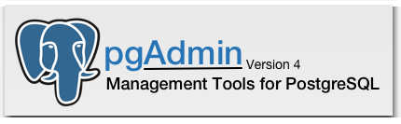
Management Tools
psql
DataGrip
phpPgAdmin
pgAdmin

Slide 37
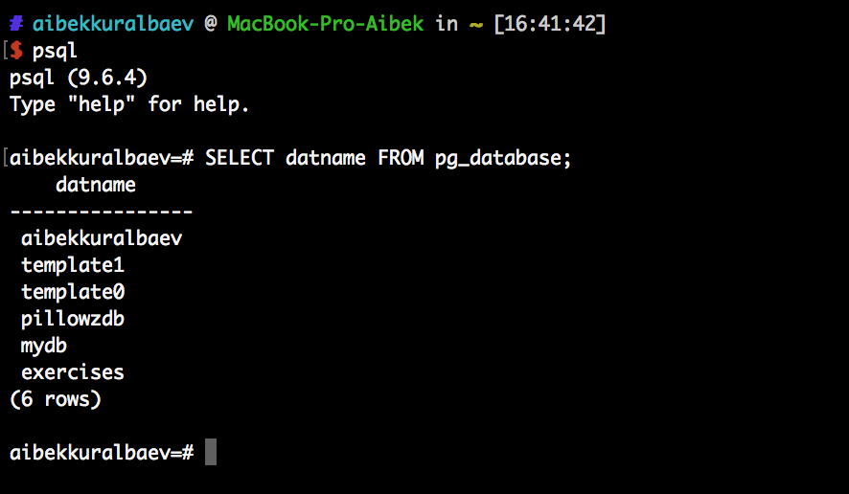
psql

Slide 38
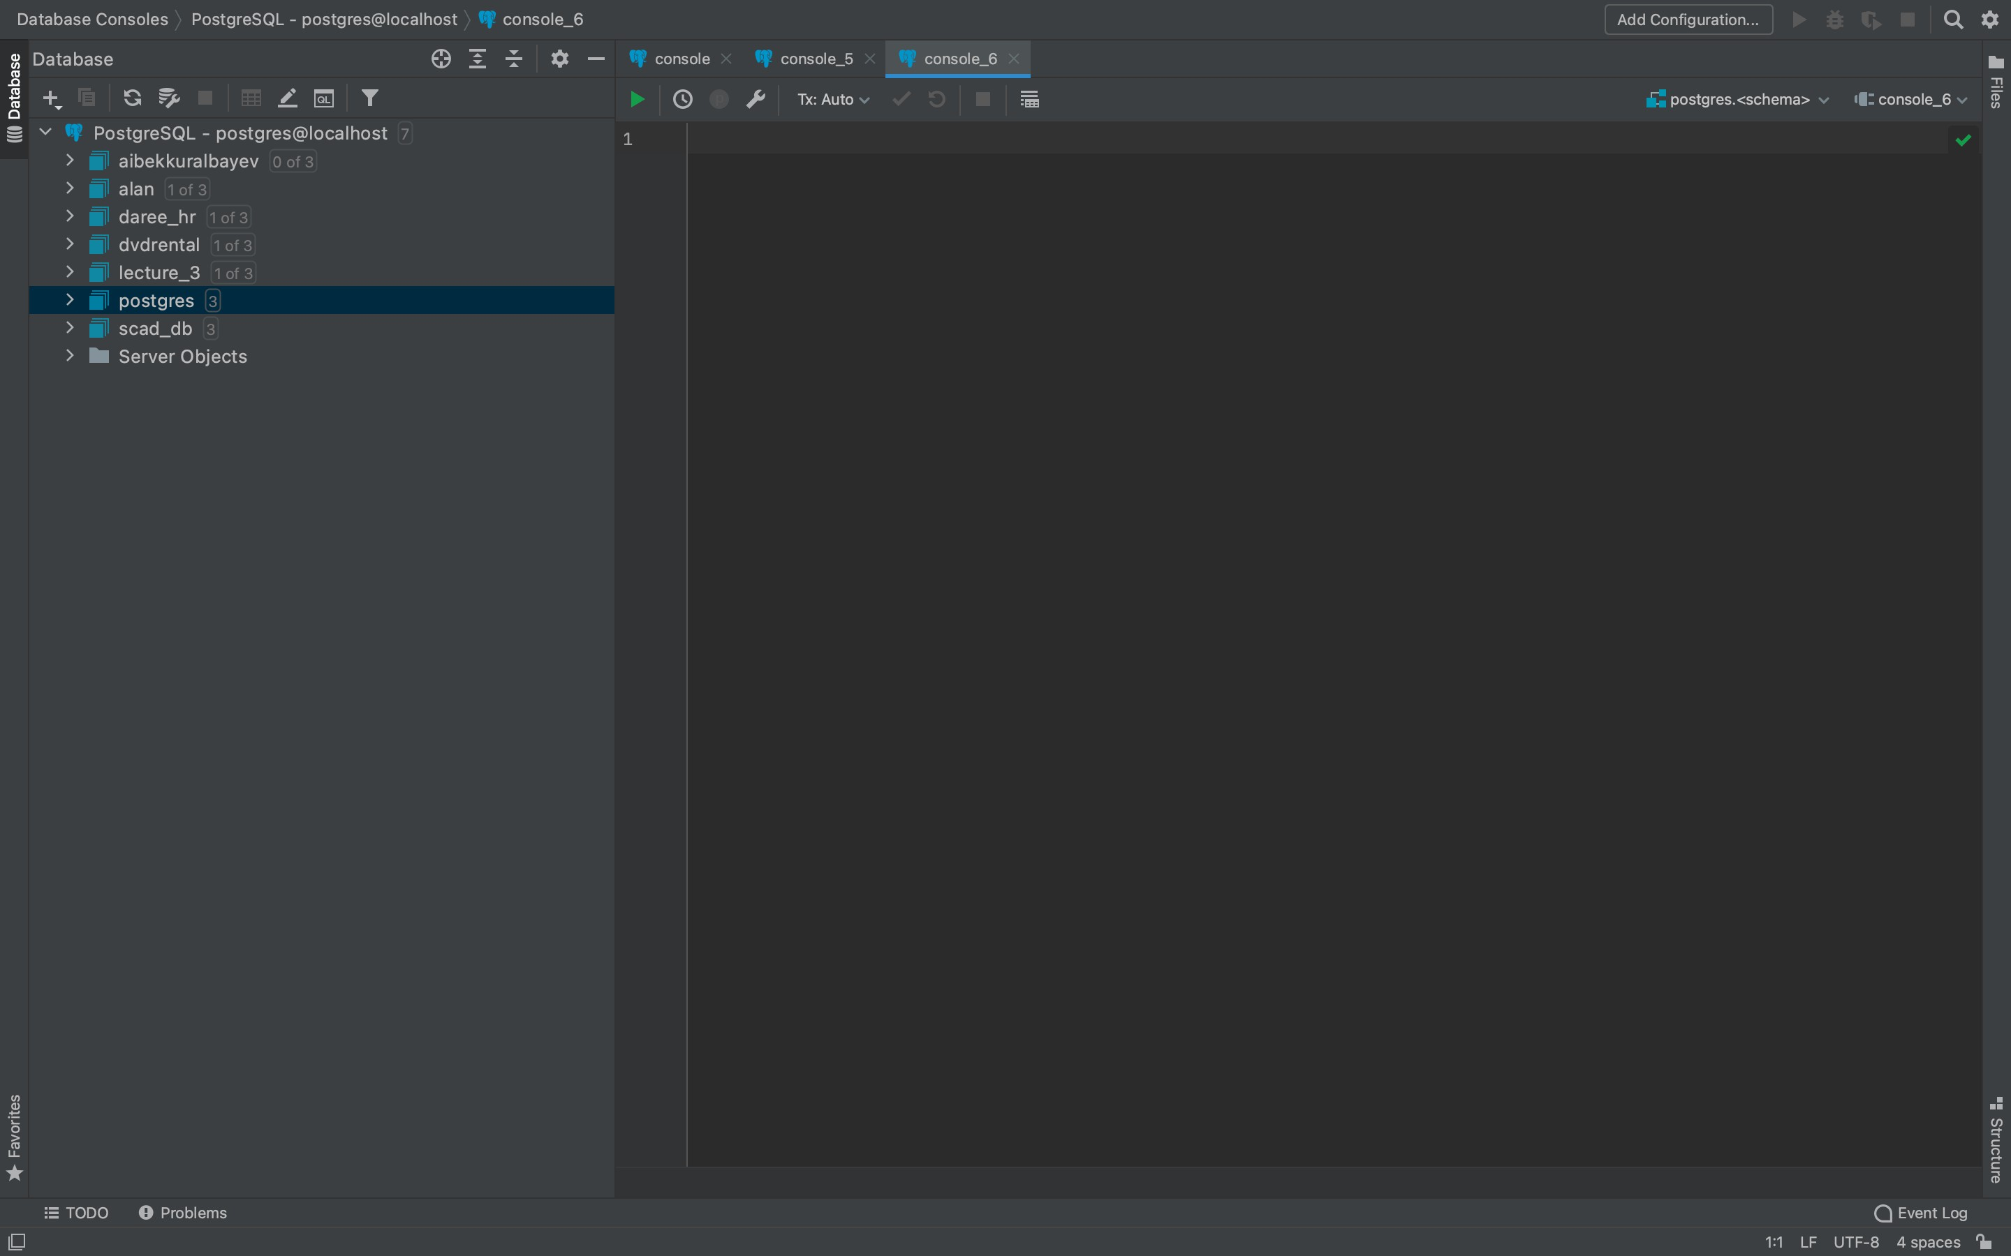
Datagrip

Slide 39
Where to Get PostgreSQL
https://www.postgresql.org/download/
https://www.jetbrains.com/datagrip/download
https://www.jetbrains.com/ru-ru/community/education/#students

